Slide 1
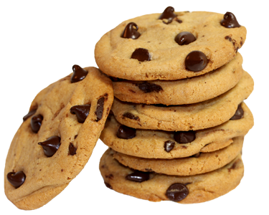

Slide 2
The average one has 10 chips. You must use flour and sugar. My grandma loves baking and this is her favorite snack.

Slide 3
Cookies
10
Ingredients
Grandma

Slide 5
